Slide 1
1.6.8.6 The multiplicative inverse

Slide 2
Introduction
In this topic, we will
Define the multiplicative inverse of a complex number
Derive it from:
The rectangular representation
The application of the complex conjugate
The polar representation
Look at a geometric interpretation
Observe some properties

Slide 3
Review
When you rationalized the denominator when the numerator was 1, you found the multiplicative inverse of the denominator:
By multiplying this by , you see indeed that this is that multiplicative inverse:

Slide 4
0 does not have a multiplicative inverse
To find the multiplicative inverse, we must first see that 0 + 0j does not have a multiplicative inverse:
If , then
Thus, 0 multiplied by any complex number can never equal 1
Thus, 0 can never have a multiplicative inverse
Thus, for z to have a multiplicative inverse:
At least one of α and β must be non-zero

Slide 5
The multiplicative inverse
We will find the multiplicative inverse of a complex number in three different ways:
The rectangular representation approach
The complex conjugate approach
The polar representation approach

Slide 6
The rectangular representation approach
We will start by finding it explicitly
If , then must be such that
Thus,
Two complex numbers are equal if and only if their real and imaginary components are equal, so

Slide 7
The rectangular representation approach
Note that this is a system of two linear equations in two unknowns γ and δ , and we will swap the two equations:
Assume β ≠ 0, so add times Equation 1 onto Equation 2:
We can multiply Equation 2 by –β and solve for δ :

Slide 8
The rectangular representation approach
Given the system of two linear equations:
We now perform a backward substitution of δ into Equation 1:
Solving this for γ, we have:

Slide 9
The rectangular representation approach
Thus, the multiplicative inverse of when β ≠ 0 is
Rewriting this, we have:
You will note that this equals:
Homework: Show this also true if we assume α ≠ 0

Slide 10
The complex conjugate approach
Let’s look at some examples:
If z = 3 + 4j then
If z = 1 – 2j then
If z = –0.3 – 0.1 j then

Slide 11
The complex conjugate approach
Let’s take a different approach:
“Rationalize” the denominator:
For example,

Slide 12
The polar representation approach
Let’s take a final approach: if , then must be a complex number such that
For this to be true, and
Solving for r and φ, we have and
Thus,
For example, if ,
then

Slide 13
The polar representation approach
Let’s check:
If , we have two formulas for the multiplicative inverse:
Are these the same?
Well, , so

Slide 14
The multiplicative inverse
Thus, given , we have that

Slide 15
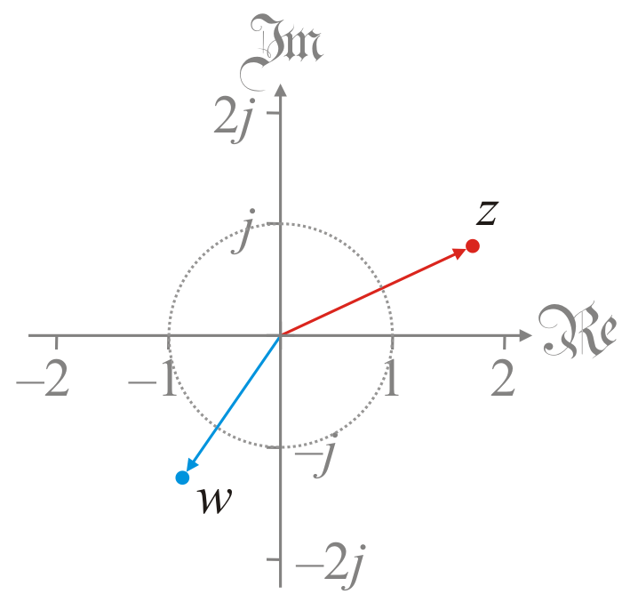
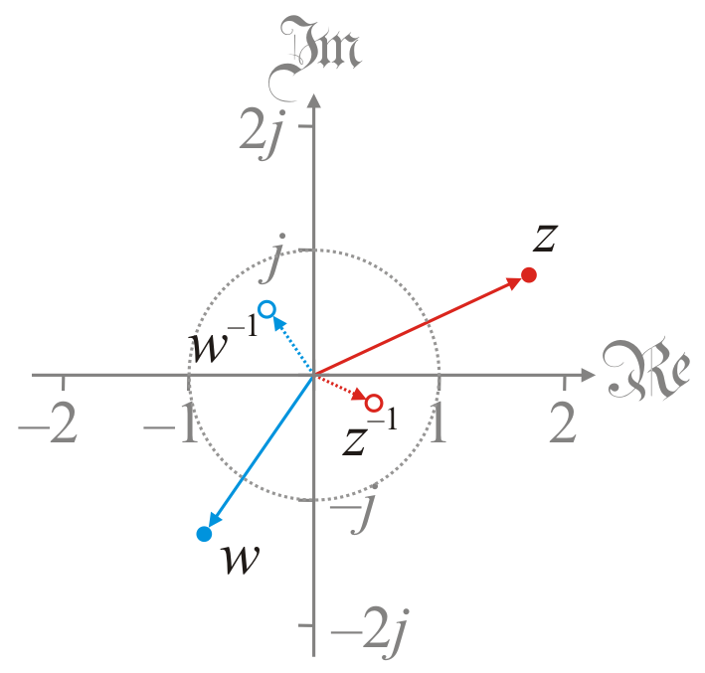
Geometric interpretation
The geometric interpretation of the multiplicative inverse is
The angle is that of the conjugate
The magnitude is one over the length of the complex number

Slide 16
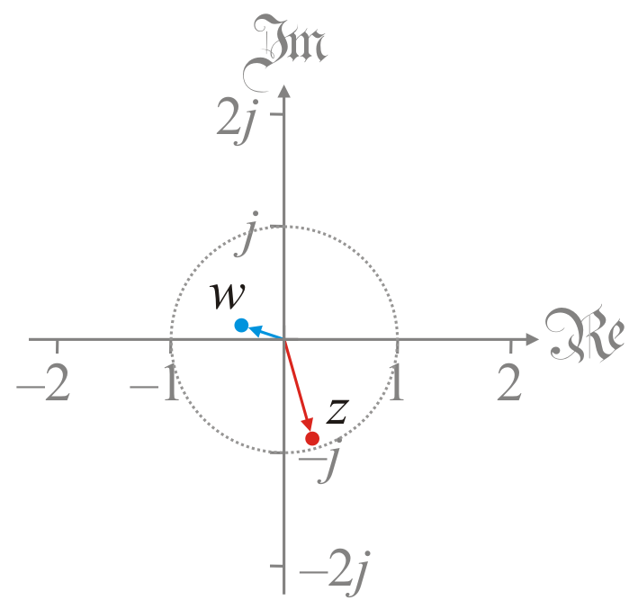
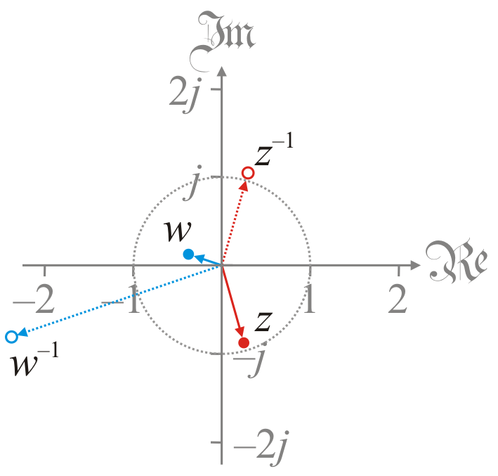
Geometric interpretation
Here are two examples where |z| < 1 and |w| < 1

Slide 17
Properties
Theorem:
Proof:
QED

Slide 18
Properties
Theorem:
Proof:
QED

Slide 19
Properties
Theorem:
Proof:
QED

Slide 20
Properties
Theorem: if and only if |z| = 1
Proof: As shown, so if and only if ,
and because , if and only if .
QED

Slide 21
Summary
In this topic, we’ve introduced the multiplicative inverse
We used three approaches to find three formulas
All three formulas are equivalent
We saw the geometric interpretation:
One over the magnitude
The angle of the conjugate
We saw a number of properties

Slide 22
References
[1] https://en.wikipedia.org/wiki/Multiplicative_inverse#Complex_numbers

Slide 23
Acknowledgments
None so far.

Slide 24
Colophon
These slides were prepared using the Cambria typeface. Mathematical equations use Times New Roman, and source code is presented using Consolas.
The photographs of flowers and a monarch butter appearing on the title slide and accenting the top of each other slide were taken at the Royal Botanical Gardens in October of 2017 by Douglas Wilhelm Harder. Please see
https://www.rbg.ca/
for more information.

Slide 25
Disclaimer
These slides are provided for the ne 112 Linear algebra for nanotechnology engineering course taught at the University of Waterloo. The material in it reflects the authors’ best judgment in light of the information available to them at the time of preparation. Any reliance on these course slides by any party for any other purpose are the responsibility of such parties. The authors accept no responsibility for damages, if any, suffered by any party as a result of decisions made or actions based on these course slides for any other purpose than that for which it was intended.

